Slide 1
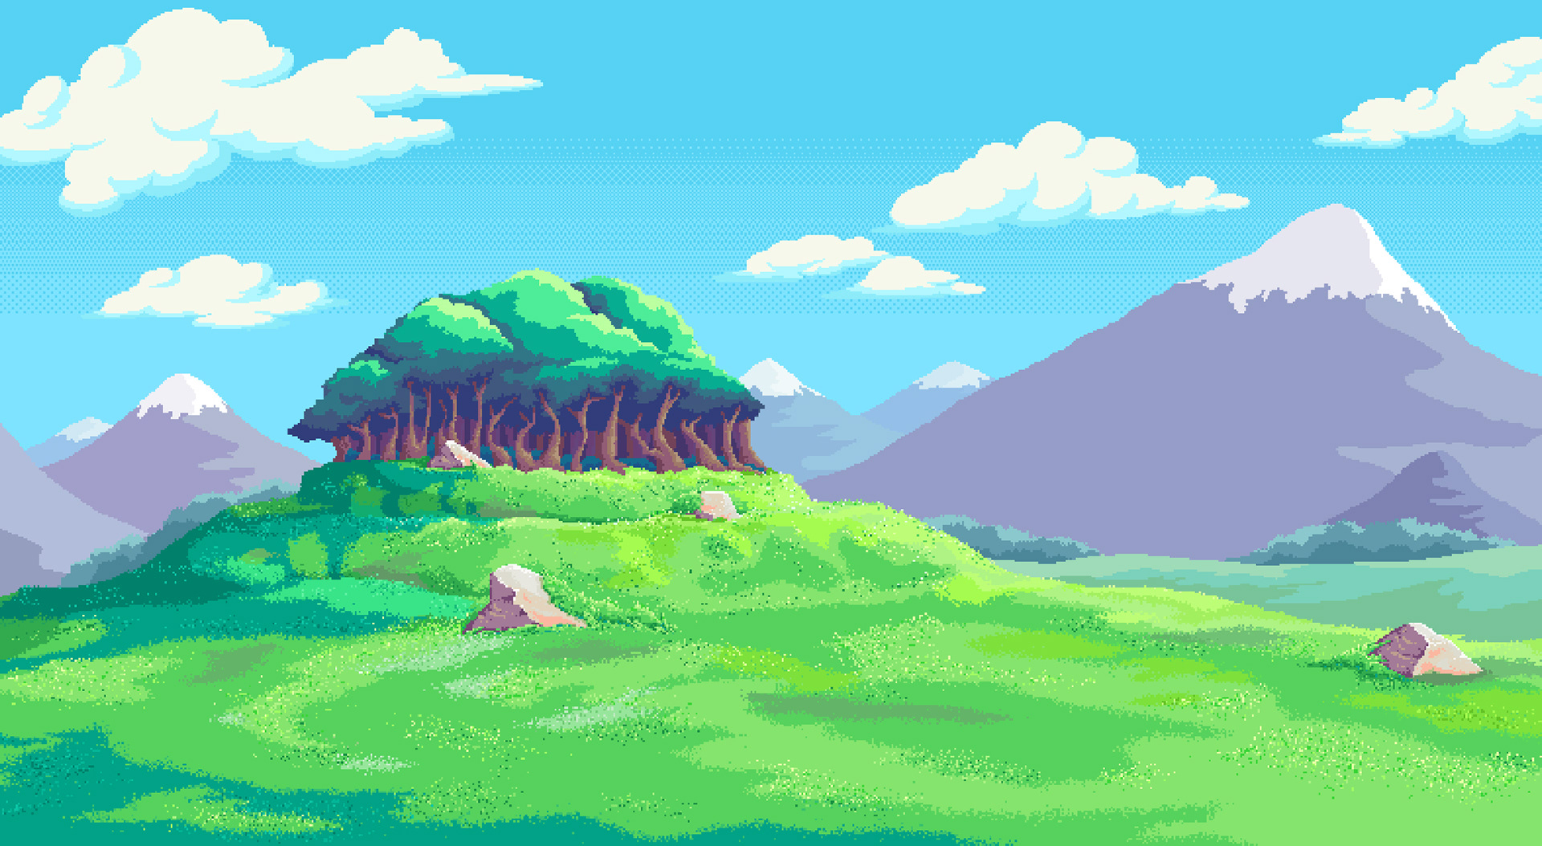



Note: For best experience, press F5 for slideshow
And turn up your volume
Diamond Hunter
A game presented to you by:
Castro, Lesmar Ace
Chan, Alecz Jasmine
Mallari, Adrian
Mamaril, Sherwin James
Ofrancia, Lianne Aundre
CITCS 1C

Slide 2



Storyline
While on a quest to become rich, Adrian set out on a journey to hunt for diamonds in a deserted diamond-rich forest
While looking for diamonds, Adrian encounters difficulties as he realized he was stuck in an endless maze of trees and rivers
Help Adrian get out of this maze by collecting diamonds whilst finding his way out.

Slide 3
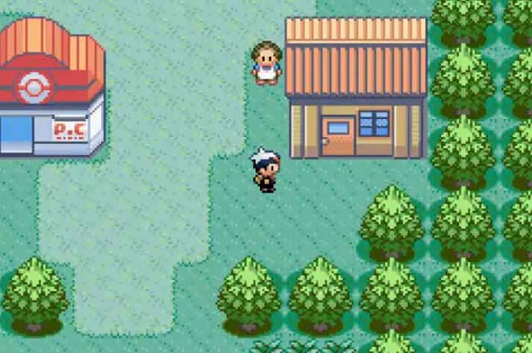
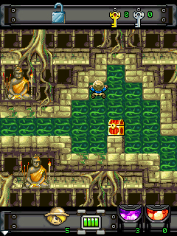
Based off from:
Pokemon Ruby
Diamond Rush

Slide 4



controls:
ADRIAN
CONTROLS
You can use either up and down arrows or WASD arrows to move Adrian across the game
Use the spacebar to activate the axe whenever you are cutting down a tree to pass by

Slide 5
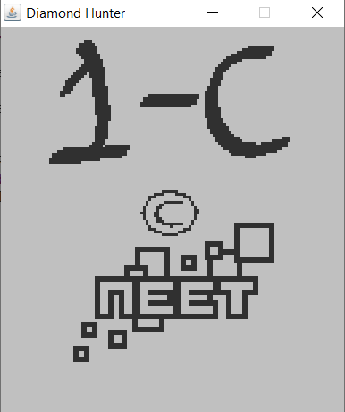
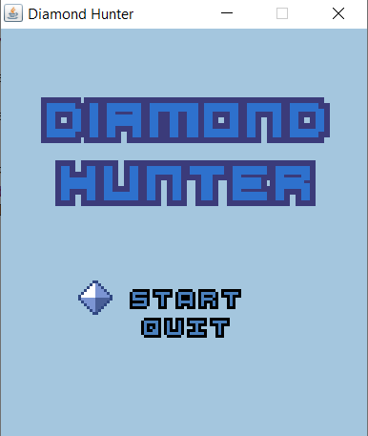
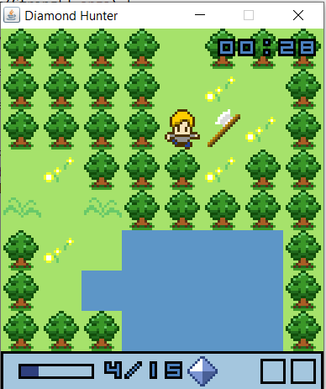
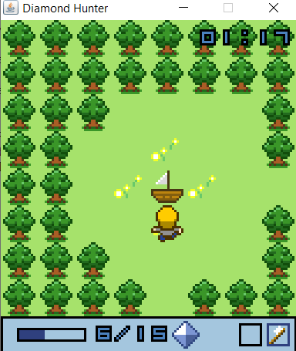
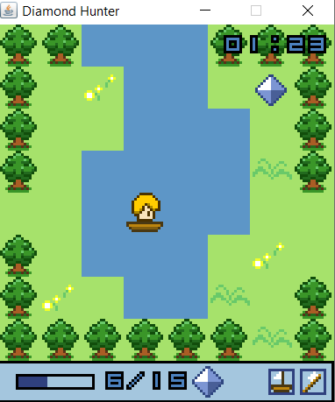
Screenshots from the game:

Slide 6
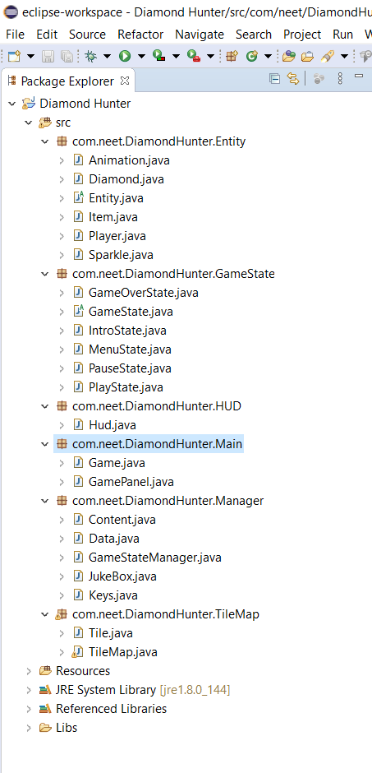
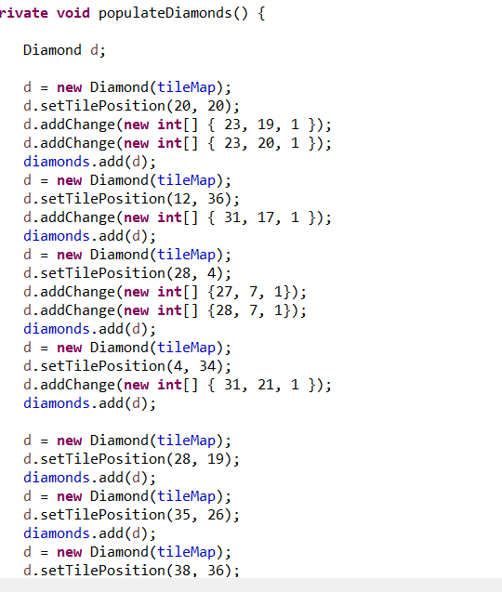
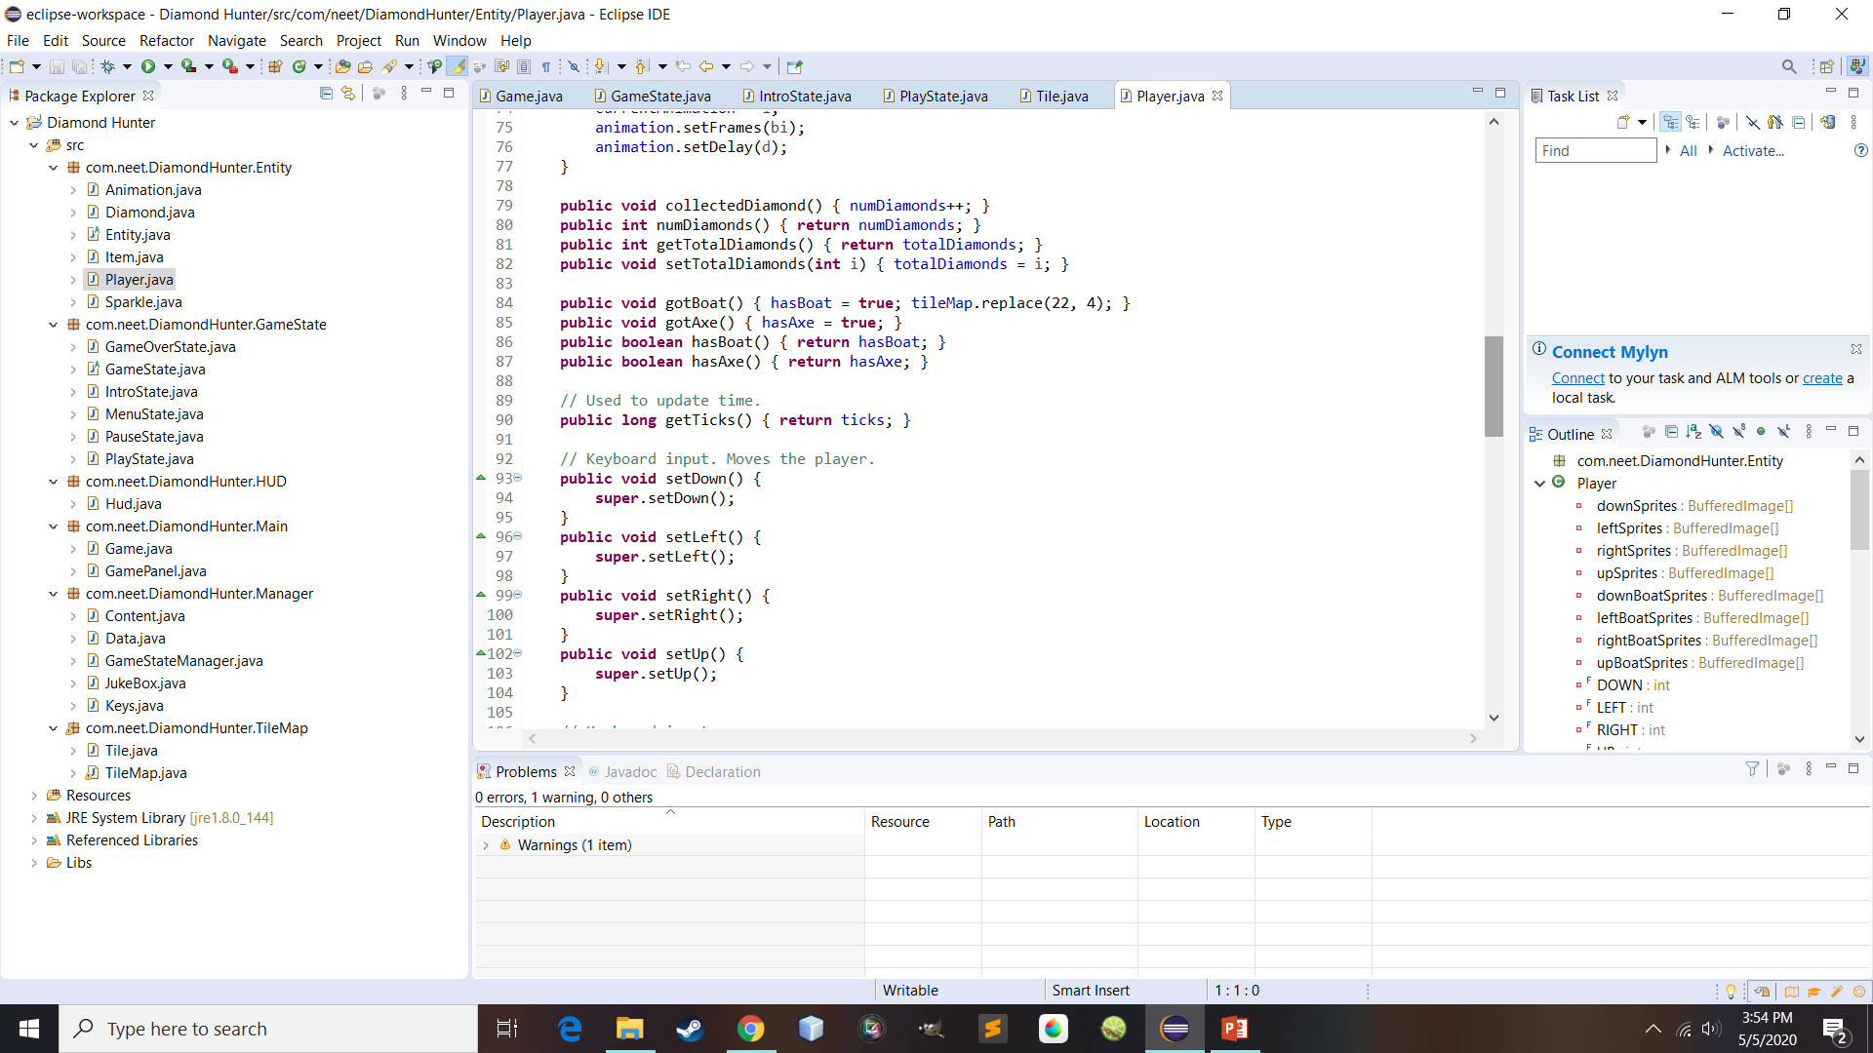
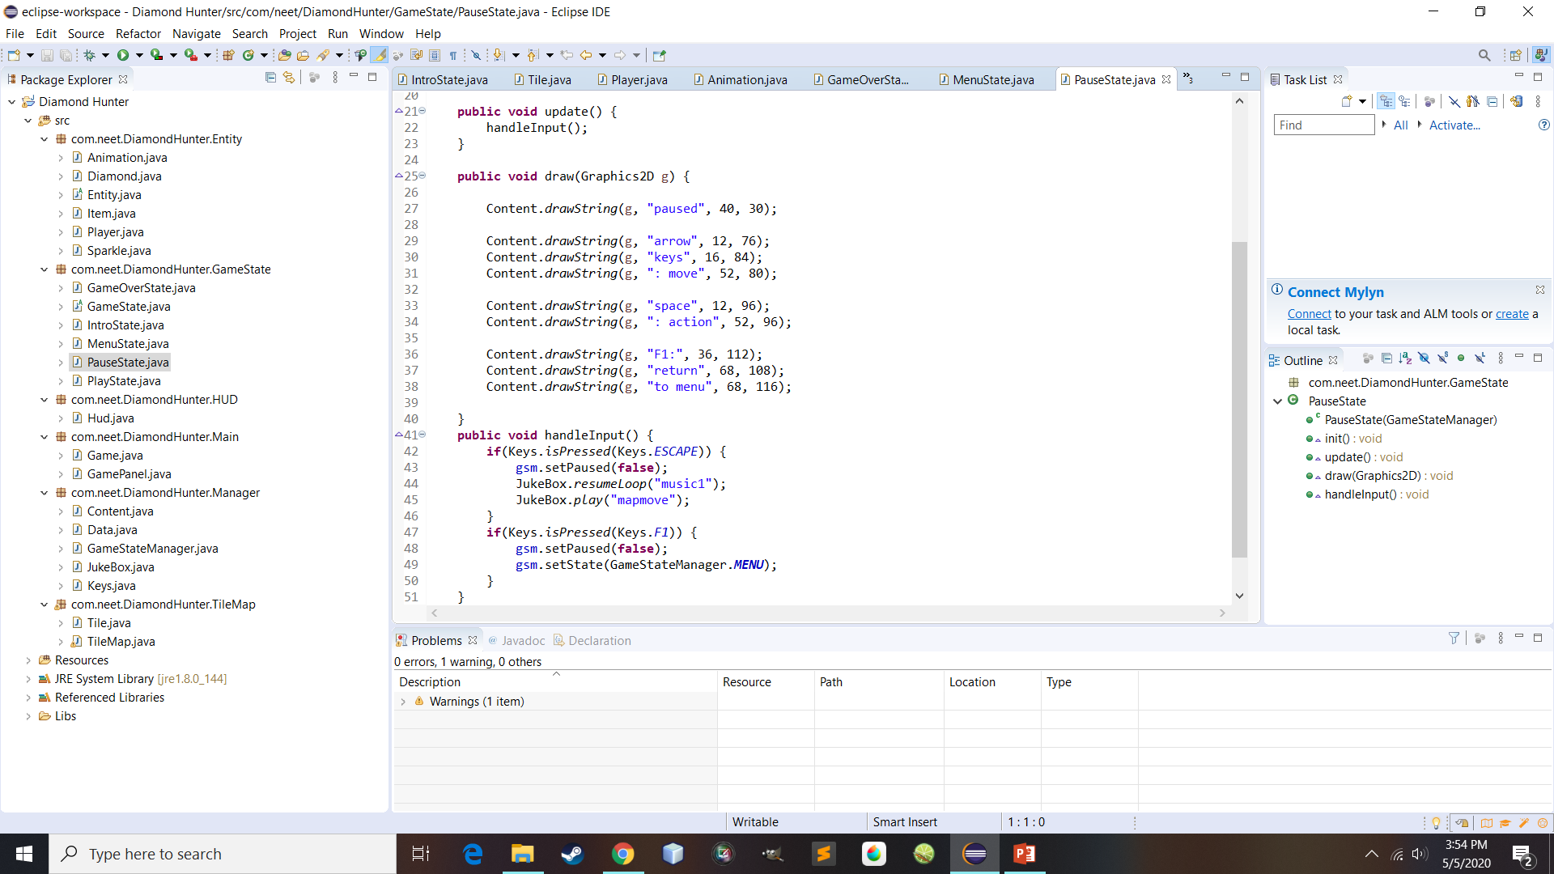
Codes screenshots:

Slide 7
Video walkthrough:
Video Walkthrough is on another link with the github ☺
Credits to the Original Owner

